Slide 1
Success factors (User Suggestions)
When talking to someone who is in, or has been in, one of the Multi-Level or Network Marketing Companies remember to cover the following:
# 1. Can we agree that what we wanted when we started was: to own our own business with no overhead, no employees, or other hassles of traditional businesses.
# 2. Can we agree that the reason people join any home based business is to: Create a lifelong reliable, willable, residual income.
Then say what we can’t forget is the one lifelong principle: the 80/20 Rule. Examples: (A) if you have 10 dentists, 2 will make more money than the other 8 (B) 20% of the people at church or any organization will end up doing 80% of the work, right?

Slide 2
The success factors
MLM – Network Marketing
Vs
Melaleuca’s Consumer Direct Marketing

Slide 3
Success factors
When you started your own home-based business were you looking for a traditional business with all the regulations, overhead, inventory, and other requirements, or did you want one with no overhead, and no employees, and no costly facilities, and none of the hassles of traditional businesses?
Would you agree that the reason people join any home-based business is to create a lifelong, reliable, willable, residual income?
Remember the 80/20 rule of life:
20% do most of the work, earn the money, etc.
Example A: If you have 10 dentists, 2 will make more money than the other 8
Example B: 20% of the people at church or any organization will end up doing 80% of the work, right?
Would you agree that a successful home-based business must be doable by the majority of the people involved?

Slide 4
Success factors
The reason that George and Jim McCune stopped doing the Amway business was that they could no longer look people in the eye and tell them that they could do it, when they knew that most people couldn’t do it. After 8 hard years George and Jim were not making any net money just like 98% of the people who were just spending money going to trainings, buying tapes, books and going to Dream Weekends.
Folks like former Emeralds, Norm & Cathy Persio, Doug Dicke, Ken & Laurie Groves and others spent even more years than George and Jim trying to make their dreams come true.
Here are some contrasts between most MLM Deals and Melaleuca:

Slide 5
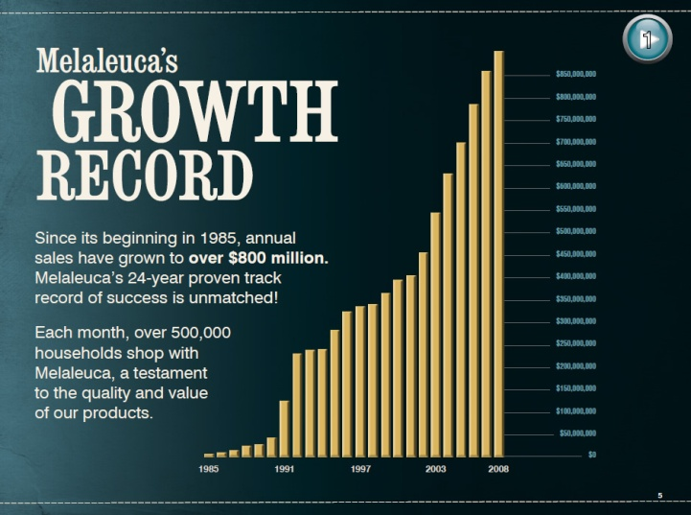
COMPANY TRACK RECORD
Most MLM companies fail and go out of business within the first five years. Most of the folks pitching the opportunities are just “glorified sales reps” hawking overpriced products.
Many of the top leaders of new companies are given positions at the top and in most cases are paid to come and bring their organizations.
Melaleuca is in their 25th year of
consistent growth. $887 million
in volume last year and still
growing. Never late on a check
in all that time and I have never
had a product back ordered.

Slide 6
FINANCIALLY SOUND
Most MLM Companies lease office space and purchase a computer program, logos, labels, product, etc. and have no real investment. They do not manufacture anything!
Examples: Fortune High Tech Mkt., Market America, 2/7 Inc., YTB Travel, ACN, and many of the juice companies. Some might own their buildings but still do not have a major investment and when the going gets tough, the owners have made their money and close the doors leaving their distributors high and dry, and BROKE!
Melalueca owns their facilities world wide and are totally
debt free. Not MLM but Consumer Direct Marketing.
Melaleuca invested over $111 Million in expanded facilities
over the past two years alone.
Being debt-free means our company will be there when you
children inherit your business. A business you can rely on.

Slide 7
STRONG MANAGEMENT
Most MLM companies, especially the newest ones that started within the last 10 years were started by a group of MLMers who came from other companies thinking they could manage a company. Most of the owners also own the downlines and make their money both ways: Examples: Some of the Juice companies, Liberty Health and others.
Melaleuca is “Built On Solid Principles”
Corporate leaders come from Fortune 500 companies: ADP, Revlon, Schick, Ohio Bell, Gillette, Proctor & Gamble, Cox Communications, UPS. This equals sound minds.
Principle-centered / Mission-driven
Currently building over $111 Million in new facilities
Completely DEBT FREE

Slide 8
STRONG MANAGEMENT (RECOGNIGTION)
No hype: CEO Frank L. VanderSloot – vision / integrity
+ Board of Ethics of the DSA,
Past Regional Vice-Chairman Washington U.S. Chamber of Commerce, currently on Board of Directors U.S. Chamber
1998 Idaho Business Leader of the year
2001 Entrepreneur of the Year
Melaleuca received the
Esteemed Torch Award from the
Better Business Bureau, 2008.
In Better Business Hall Of Fame.

Slide 9
Unique consumable products
Most of the juice companies only have 3 or 4 products and most are made, bottled and labeled by a jobber. In other words most are made by one or two California companies for less than $4.00 or $5.00 a bottle and sold for $35.00 to $40.00 to the distributor and customers. Their people are distributors, they have to sell a large portion of what they buy. The companies who just sell services have nothing unique. Some companies try to add a few nutritional, skin care and home cleaning products to try to build a residual income into their plan.
More than 350 superior quality, safer products protected by trade secrets, proprietary formulas and patents – can only be obtained through Melaleuca
Don’t have to create the “need to buy” products everybody already uses.
Even in tough times, everyone has to use products for personal hygiene, skin care and cosmetics (the avg. women spends $600 per year), clean the house, wash the clothes, take nutritional products, use weight management products and sports nutrition products. WE ARE NOT DISTRIBUTORS!
People are already buying these types of products…no new money.
Monthly consumption and automatic reorder of household basics creates the residual income. It’s RECESSION PROOF!

Slide 10
Competitively priced
Forty dollars for a bottle of fruit juice! Give me a break! Many charge twenty nine to fifty dollars a month for a company sponsored website. A good example is Amway/Quixtar, they do have some good products but they usually cost 2 to 3 times what grocery store products cost. Other companies are just jobbers and have to build profit into the price of their supplier’s prices.
Price point is supermarket or lower. Save 15% – 75% on a cost per use basis compared to Walmart, WalGreens, etc.
New customers get $20 in free products in each of the first five months and 10% of each monthly order in free loyalty dollars redeemable in free products thereafter.
Smart economics – great value for just being a customer.
Manufactures their own products – complete control. (Many prices are nearly the same after 25 years!)

Slide 11
High reorder rate
When we were with Amway we usually had about a 12% reorder
rate (probably still about the same). Many of the Juice
companies have about a 25% reorder rate.
Can you really build a residual income with that kind of reorder rate?
How many folks do you think are going to pay $35 to $40 for a bottle
of fruit juice when the budget gets tight…or pay close to $150 for a
box of Amway XX Vitamins?
Documented 95% of the customers who order this month will order again next month. (Even the utility companies would like that reorder rate.)
Consumer s love our products – creates long -term residual income.
Melaleuca is the only company proud to show their Business Report.

Slide 12
Low personal production requirement
Can you ask your Mother to spend $160.00 a month for a fruit Juice and
be on auto ship to get it? She has to order that much.
Or can you ask a young couple with 2 or more kids to spend that kind of
money a month and still have to pay for a website?
Some of the Juice companies want you to purchase a case for both
husband and wife and one to give away for samples and be on auto ship
for that also.
Auto ship is a sinking ship!
Only required to purchase 35 product points (about $50 to $60) monthly and the most you ever have to purchase even as a Corporate Director is 75 points .
No new money required – no need for a budget change – simply switch stores
Everyone can be a customer.

Slide 13
Low entry fee
Many companies want you to come in “right” for $1,500, $2,500, even
$5,000 to start if you are a hitter.
Rexall which is no longer in business got folks to start for $5,000. Even
Mary Kay and Beauty Control want you to spend that much to start.
Some will let you start for $30.00 to $50.00 but tell you if you really want
to “play”, you will need to find a way to get the big packages.
Only $29.00 to start, plus place an order.
For the player: a Value Pack (about 40 products from each category for you to use and see how good they are) is only $199; a Career Pack (about 70 products) is only $299.
Become a Director in the first two months and earn a $200 bonus, which pays for the Value Pack. A Pacesetter Pack (optional) includes a Value Pack and 10 of the $29 membership kits for only $550 (same price as 16 years ago, and you get the $550 back by enrolling ten customers with the help of your support team. You then have all of your money back and be in profit.) Plus the Value Pack and your membership kit is tax deductable!
Enroller is not paid bonus on fee
Come in the “right way” - not buying inventory!

Slide 14
Low attrition
Most are like a VP of one of the juice deals told one of the good folks in North Carolina who he was on a 3-way call with, “you just have to put them in faster than they go out”.
That is exactly how it was when we were in Amway after the first couple of years.
Company has a documented monthly reorder rate of 95%! People will use our products even if they don’t do the business.
This legitimate business is not a sign-up game.
60% are just brand loyal customers; equals a stable, residual income

Slide 15
Timing
After a MLM deal has gone through an area, folks will not even listen anymore. A good example is Amway. For years, even since the 70’s, they have not been able to mention the name Amway when approaching potential prospects. The same thing has started happening to the Juice companies, ACN, Pre-Paid Legal, YTB Travel and other MLM companies.
Melaleuca is in their 25th year and well over 90% of the people in North America still have never heard of it.
No bad news about Melaleuca; no one is getting hurt. Bad news travels faster than good news.
Not in a hurry, not looking for shortcuts – a business built brick-by-brick, with better compensation than ever before.
Sitting squarely in the driver’s seat of supply and demand.
New person can build international business from their start.

Slide 16
No breakaways
Think of the 80/20 Rule. In the Breakaway Plans, when you find a player and they build quicker than you (which is what you are looking for), and they pass you, they break away from you. If you cannot replace their volume, you lose most of the commissions you were earning.
Binary Plans are the new Breakaways. For example: they tell you that you only have to have two legs, so you bring in a player and put them in one of the legs and your Mom in the other. After a month or so the player has 200 customers and your Mom has 10. How many do you get paid on? Just 20! Why? A binary goes against all of the rules of a successful business. You only get paid on your weakest leg and the same number of customers from the strong leg. You get paid on your Mom’s 10 and only 10 of your player. So what does that do? It encourages you to work with your Mom to try to chase or equal the volume of your player, instead of working with the player to build a large business. Who loses? Everybody but that company!
Never penalized for bringing in someone better than you.
Your business can never be taken from you! You may have to do a little more to collect all of the bonuses, but you never lose it like in the Breakaways. Binariies really are the new Breakaways!
You get paid for all customers brought in, unlike the Binaries.

Slide 17
NO RISK
Some reports say that 98% of the people who start in MLM deals do not make a penny. In fact they lose money.
Do you want to put your mom or your church friends at that kind of risk? It’s not just about the money they lose. It’s also about the time that they cannot get back, and their reputation.
Remember your Mom can do Melaleuca because all she has to do is use the products and refer customers. She does not have to sell anything, stock or inventory anything .
In Melaleuca, everything is fully refundable. All products are 100% satisfaction guaranteed for 60 days. Even the $29 for the Membership Kit is refundable for the first 120 days.
No one can get hurt.
A business the 80%’ers can do.
There is NO RISK whatsoever!

Slide 18
Question?
Which one of these 12 points would you be willing to take off the page and still throw your time, energy and reputation into it?
(A very few companies, for example Amway, might have three or four of the Success Factors, but nobody but Melaleluca has all twelve).
Are you just looking for the next one, or are you looking for the last one?
Company Track Record
Financially Sound
Strong Management
Unique Consumable Products
Competitively Priced
High Reorder Rate
Low Personal Production Requirement
Low Entry Fee
Low Attrition
Timing
No Breakaways
No Risk
All Roads Lead To Melaleuca!

